Slide 1
Advanced Systems Analysis and Design Architecture design SOFT 30121 L11

Slide 2
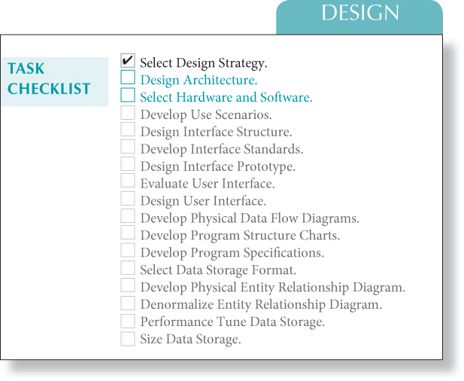
Architecture design
RecoSystems Analysis and Design
Alan Dennis; Barbara Haley Wixom; Roberta M. Roth
2019
Chapter 7

Slide 3
Architecture Design
Objectives of Lecture 6
Describe the fundamental components of an information system.
Describe client–server, server‐based, and mobile application architectures.
Describe how cloud computing can be incorporated as a system architecture component.
Explain how operational, performance, security, cultural, and political requirements affect the architecture design.
Estimate the build to be able to complete the planning part of the 1st hand in.

Slide 4
Introduction
Creation of the architecture design includes the plan for how the information system components will be distributed across multiple computers and what hardware, operating system software, and application software will be used on each computer (e.g., cross-platform software).
Designing the system architecture can be quite difficult; therefore, many organizations use the skills of experienced, expert system architects (consultants or employees) who specialize in the task.
Specialists ensure that the new system is developed as a unified, coherent software system that satisfies the user and functional requirements and conforms to the organization's architectural standards and goals.

Slide 5
Architectural Components
The major architectural components of any system are the software and the hardware.
The major software components of the system being developed have to be identified and then allocated to the various hardware components on which the system will operate.
Each of these components can be combined in a variety of different ways.
All software systems can be divided into four basic functions:
data storage: data entities documented in ERDs;
data access logic: Structured Query Language (SQL);
application logic: documented in the Flow Diagrams;
presentation logic: display of information to the user and the acceptance of the user's commands;

Slide 6
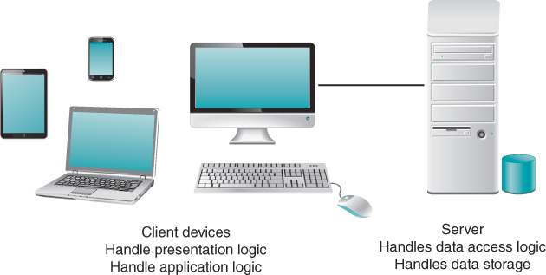
Client–Server Architectures
Attempt to balance the processing between client devices and one or more server devices.
In these architectures, the client is responsible for the presentation logic, whereas the server is responsible for the data access logic and data storage.
Most of the application logic, it is called a thick or fat client.
Thin clients, containing just a small portion of the application logic, are popular because of lower overhead and easier maintainable.
Client–server architectures have four important benefits:
Scalable
support many different types of clients and servers.
simple to clearly separate the presentation logic, the application logic, and the data access logic
only the applications requiring that server will fail

Slide 7
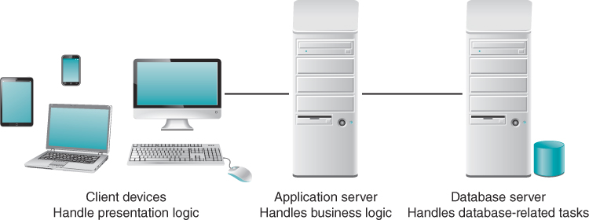
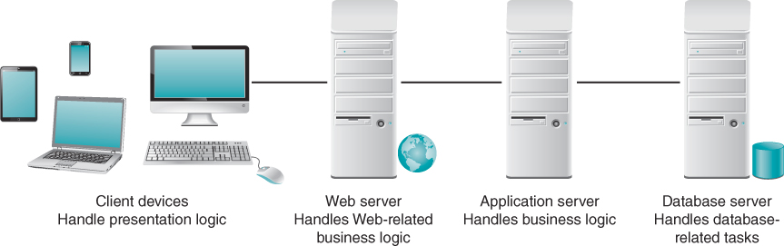
Client–Server Tiers
two‐tiered architecture: the server is responsible for the data and the client is responsible for the application and presentation.
three‐tiered architecture: the software on the client computer is responsible for presentation logic, an application server(s) is responsible for the application logic, and a separate database server(s) is responsible for the data access logic and data storage
n‐tiered architecture distributes the work of the application (the middle tier) among multiple layers of more specialized server computers.

Slide 8
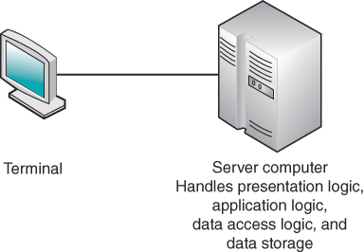
Server‐Based Architecture
Was the first architecture used in information systems but did not remain the only option as hardware and software evolved.
the server (usually, a central mainframe computer) performs all four application functions.
The clients (in those days, “dumb” terminals) enable users to send and receive messages to and from the server computer.
The clients merely captured keystrokes and sent them to the server for processing, and accepted instructions from the server on what to display.
Zero client, or ultrathin client, is a server‐based computing model that is often used today in a virtual desktop infrastructure (VDI).
The zero client computing model provides an efficient and secure way to deliver applications to end users.
Administration is easy and multiple virtual PCs can be run on server class hardware in VDI environments, significantly reducing the number of physical PCs that must be acquired and maintained.

Slide 9
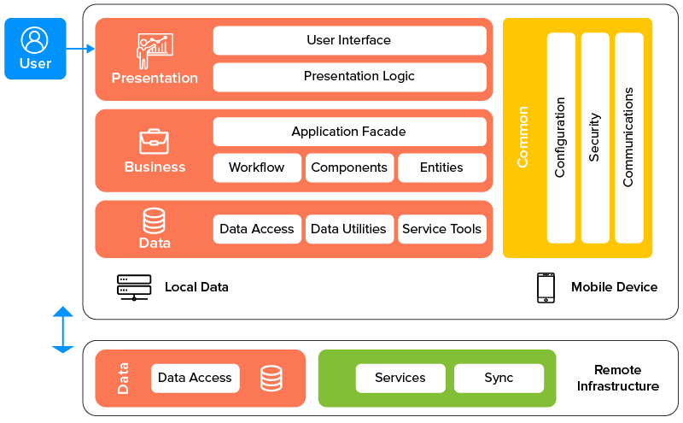
Mobile Application Architecture
In recent years, the variety and capability of mobile devices, such as tablet devices and smartphones, has led to a huge increase in demand for mobile consumer and business applications.
Opportunities abound to connect and inform both customers and employees.
If the application requires local processing using the mobile device's resources, such as the camera or GPS, and is only occasionally connected to the server, it should be created as a rich client.
Rich clients, the business and data access logic are included on the device along with the presentation logic.
technology choices for mobile applications:
native applications,
cross‐platform frameworks, and
mobile Web apps.

Slide 10
Advances in Architecture Configurations
Virtualization
Server virtualization involves partitioning a physical server into smaller virtual servers.
Software is used to divide the physical server into multiple virtual environments, called virtual or private servers.
Storage virtualization involves combining multiple network storage devices into what appears to be a single storage unit.
A storage area network (SAN) uses storage virtualization to create a high‐speed subnetwork of shared storage devices.
Cloud Computing
wherein everything, from computing power to computing infrastructure, applications, business processes to personal collaboration—can be delivered as a service wherever and whenever needed.
The “cloud” in cloud computing can be defined as the set of hardware, networks, storage, services, and interfaces that combine to deliver aspects of computing as a service. Cloud services include the delivery of software, infrastructure, and storage over the Internet
the resources allocated can be increased or decreased based upon demand also known as elasticity
Arrangements are made with the cloud service provider for a certain amount of computing, storage, software, process, or other resources. After using these resources, they can be released if no longer required.
cloud services typically have standardized application program interfaces (APIs) where the services have standardized the way that programs or data sources communicate with each other.

Slide 11
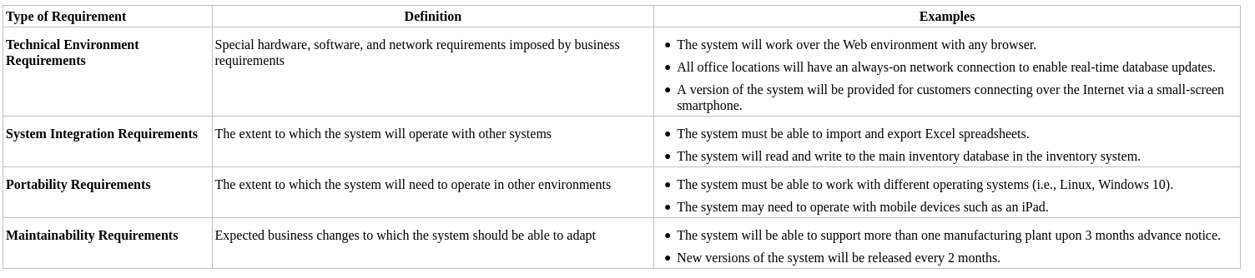
Creating an Architecture Design
Operational requirements
Technical environment requirements specify the type of hardware and software on which the system will work.
Portability requirements define how the technical operating environments may evolve over time and how the system must respond.
Maintainability requirements specify the business requirement changes that can be anticipated.
Performance requirements focus on performance issues such as response time, capacity, and reliability.

Slide 12
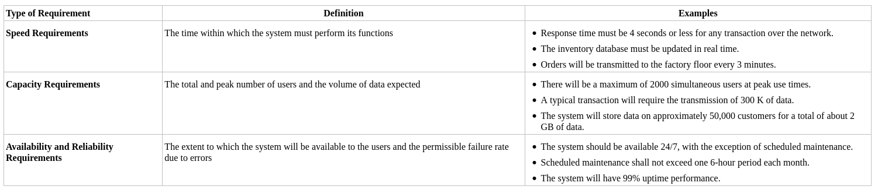
Creating an Architecture Design
Performance Requirements
Speed requirements are exactly what they say: how fast the system must operate.
Capacity requirements attempt to predict how many users the system will have to support, both in total and simultaneously.
Availability and reliability requirements focus on the extent to which users can assume that the system will be available for them to use.

Slide 13
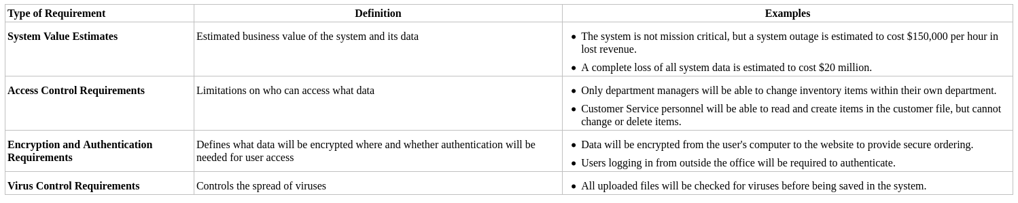
Creating an Architecture Design
Security Requirements
System value: the most important computer asset in any organization is not the equipment; it is the organization's data.
Access control requirements state who can access what data and what type of access is permitted—whether the individual can create, read, update, and/or delete the data.
The encryption and authentication requirements state what encryption and authentication requirements are needed for what data.
The single most common security problem comes from viruses.

Slide 14
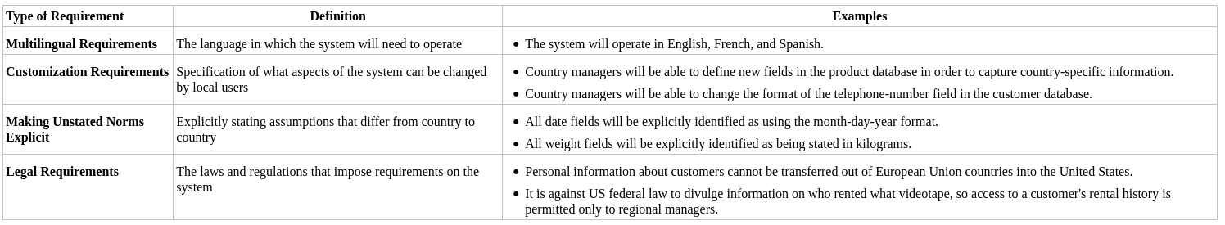
Creating an Architecture Design
Cultural and Political Requirements
Global applications often have multilingual requirements, which means that they have to support users who speak different languages and write with non‐English letters.
Customization requirements: how much of the application will be controlled by a central group and how much of the application will be managed locally? For example, some companies allow subsidiaries in some countries to customize the application by omitting or adding certain features.
Many countries have unstated norms that are not shared internationally.
Legal requirements are imposed by laws and government regulations.

Slide 15
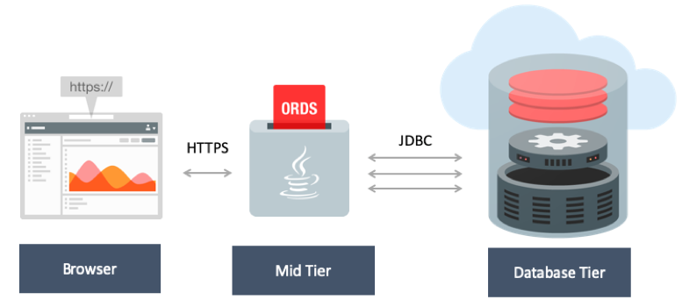
Example Architecture: Oracle Apex

Slide 16
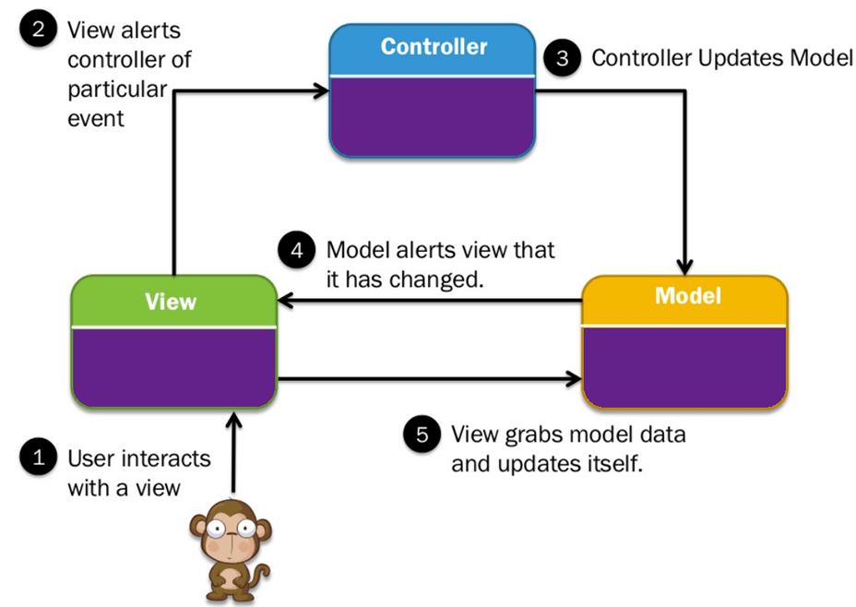
MVC Architecture
Not Mentioned in the Book
A very popular architectural framework.

Slide 17
Architectural frameworks using MVC
Ruby on Rails
Django
Spring MVC
Flask

Slide 18
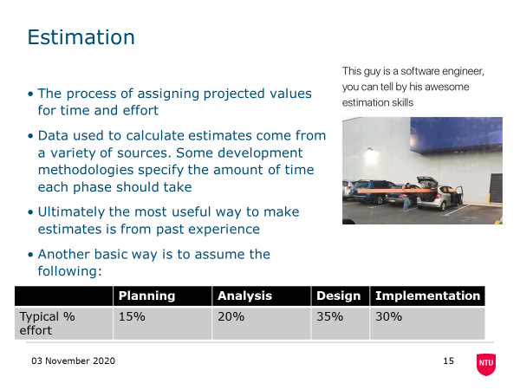
Putting Estimates in your plan
I want to make sure every team is building its estimates into their plan. Remember lecture 3

Slide 19
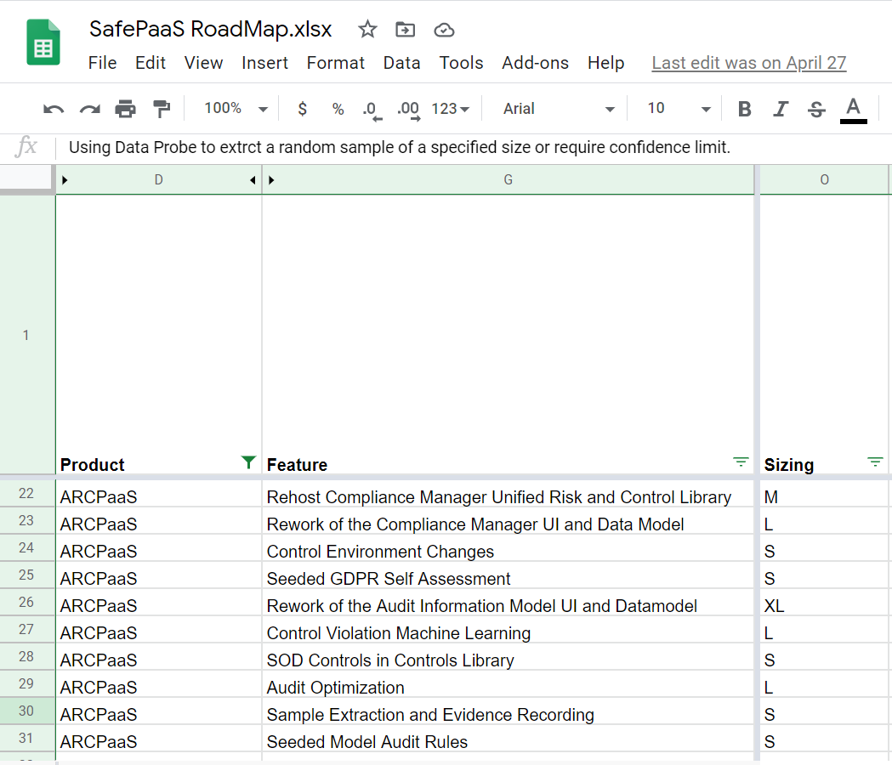
We should have a set of requirements now
See if you can judge their relative size. I find T Shirt sizing to be the easiest estimating methodology.

Slide 20
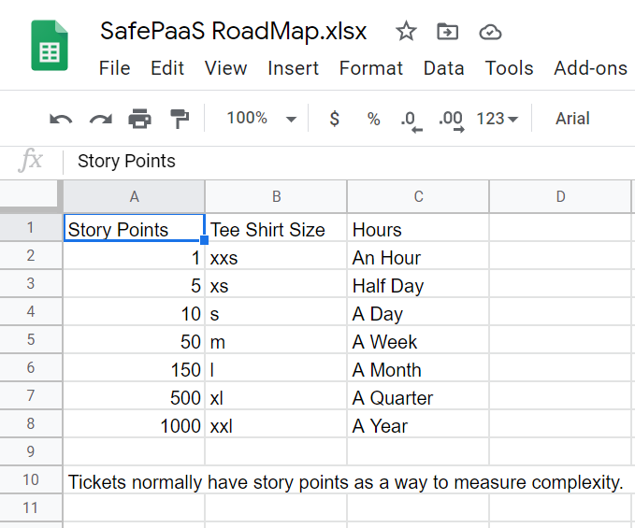
The T-Shirt sizes need a conversion to get them into person days.

Slide 21
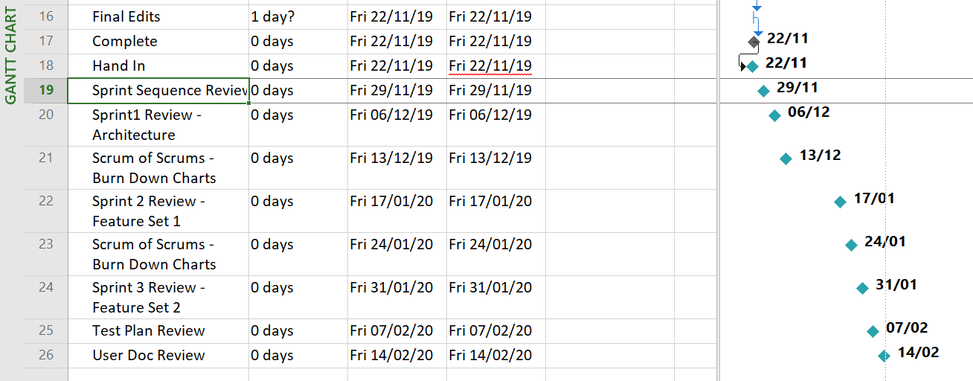
Get the tasks into the plan
A gantt chart is a fine way to represent the plan.

Slide 22
Next Lecture
User Interface Design

